Slide 1
Day 3
Hibernate

Slide 2
Objectives
Inheritance Mapping
Inheritance Mapping
Table Per Hierarchy
TPH using Annotation
Table Per Concrete
TPC using Annotation
Table Per Subclass
TPS using Annotation open link
HQL
Hibernate with Collection

Slide 3
Inheritance Mapping
We know inheritance concept very well now,
In Hibernate we can map the inheritance hierarchy classes with the table of the database.
There are three inheritance mapping strategies defined in the hibernate:
Table Per Hierarchy
Table Per Concrete class
Table Per Subclass

Slide 4
Table Per Hierarchy
Take an example for understanding Table per Hierarchy
Class Car
Int carId
String CarName
Class EconomicalCar extends Car
Float carPrice
float carMilage
Class LuxuriousCar extends Car
Int EngineCapacity
String luxuriousFeatures

Slide 5
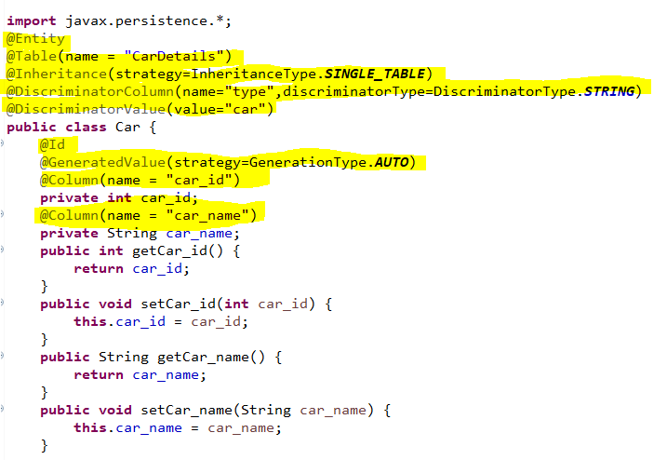
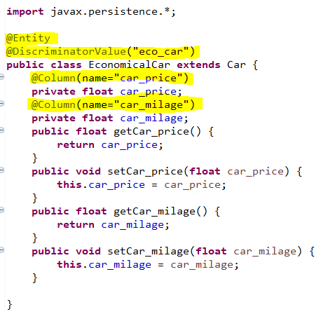
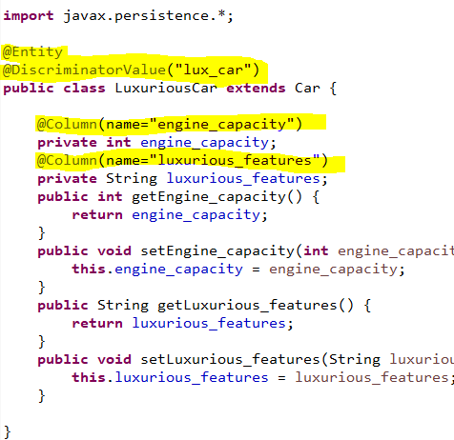
Hibernate Table Per Hierarchy using Annotation
In table per hierarchy mapping, single table is required to map the whole hierarchy, an extra column (known as discriminator column) is added to identify the class. But nullable values are stored in the table

Slide 6
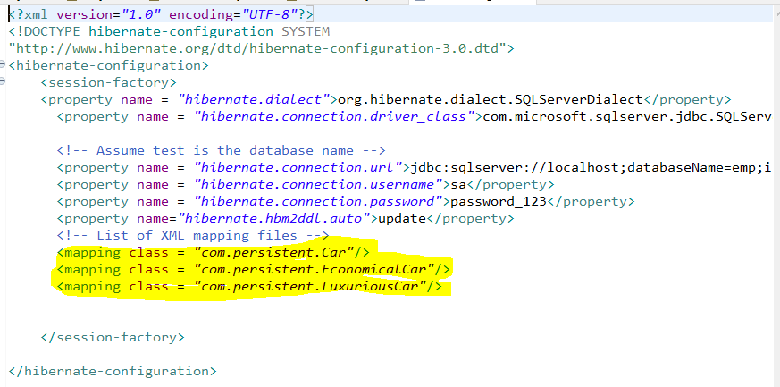
Hibernate Table Per Hierarchy using Annotation

Slide 7
Table Per Concrete class using xml file
In case of Table Per Concrete class, there will be three tables in the database having no relations to each other. There are two ways to map the table with table per concrete class strategy.
By union-subclass element
By self creating the table for each class

Slide 8
Table Per Subclass Example using xml file D2-3
In case of Table Per Subclass, subclass mapped tables are related to parent class mapped table by primary key and foreign key relationship.
The <joined-subclass> element of class is used to map the child class with parent using the primary key and foreign key relation.
In this example, we are going to use hb2ddl.auto property to generate the table automatically. So we don't need to be worried about creating tables in the database.

Slide 9
Table Per Subclass using Annotation
We need to specify @Inheritance(strategy=InheritanceType.JOINED) in the parent class and @PrimaryKeyJoinColumn annotation in the subclasses.

Slide 10
HQL
Hibernate Query Language (HQL) is same as SQL (Structured Query Language) but it doesn't depends on the table of the database. Instead of table name, we use class name in HQL. So it is database independent query language.
Advantage of HQL
There are many advantages of HQL. They are as follows:
database independent
supports polymorphic queries
easy to learn for Java Programmer

Slide 11
Query Interface
The object of Query can be obtained by calling the createQuery() method Session interface.
The query interface provides many methods. There is given commonly used methods:
public int executeUpdate() is used to execute the update or delete query.
public List list() returns the result of the ralation as a list.
public Query setFirstResult(int rowno) specifies the row number from where record will be retrieved.
public Query setMaxResult(int rowno) specifies the no. of records to be retrieved from the relation (table).
public Query setParameter(int position, Object value) it sets the value to the JDBC style query parameter.
public Query setParameter(String name, Object value) it sets the value to a named query parameter.

Slide 12
How to use methods of Query Interface
Example of HQL to get all the records
Query query=session.createQuery("from Car");//here persistent class name is Car
List list=query.list();
Example of HQL to get records with pagination
Query query=session.createQuery("from Emp");
query.setFirstResult(5);
query.setMaxResult(10);
List list=query.list();
Example of HQL update query
Transaction tx=session.beginTransaction();
Query q=session.createQuery("update User set name=:n where id=:i");
q.setParameter("n","Udit Kumar");
q.setParameter("i",111);
int status=q.executeUpdate();
System.out.println(status);
tx.commit();

Slide 13
How to use methods of Query Interface
Example of HQL delete query
Query query=session.createQuery("delete from Emp where id=100");
//specifying class name (Emp) not tablename
query.executeUpdate();
HQL with Aggregate functions
Example to get total salary of all the employees
Query q=session.createQuery("select sum(salary) from Emp");
List<Integer> list=q.list();
System.out.println(list.get(0));
Example to get maximum salary of employee
Query q=session.createQuery("select max(salary) from Emp");
Example to get minimum salary of employee
Query q=session.createQuery("select min(salary) from Emp");
Example to count total number of employee ID
Query q=session.createQuery("select count(id) from Emp");

